Slide 1
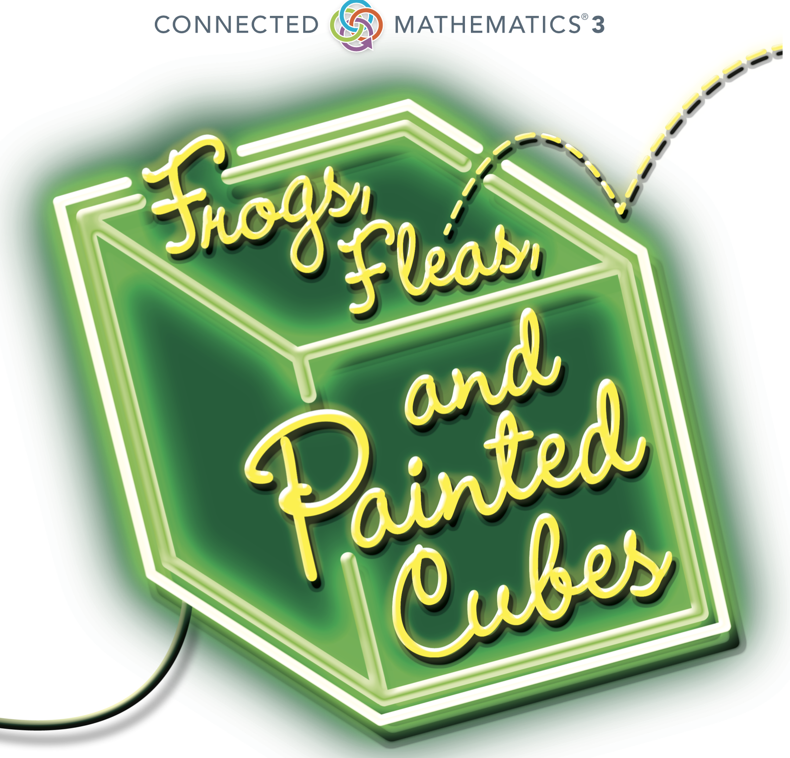
Frogs, Fleas, and Painted Cubes
Problem 4.4
Function Card Sort

Slide 2
Frogs, Fleas, and Painted Cubes| Problem 4.4
Copyright 2021 Connected Mathematics Project at Michigan State University.

Slide 3
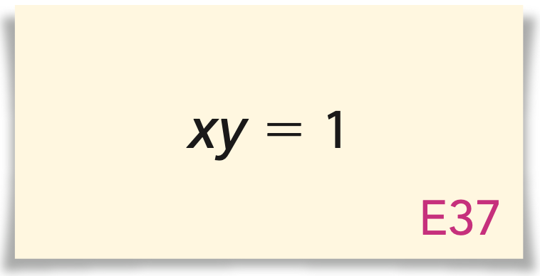
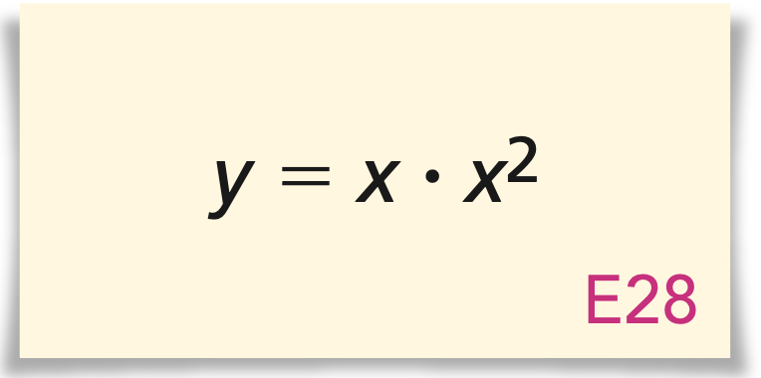
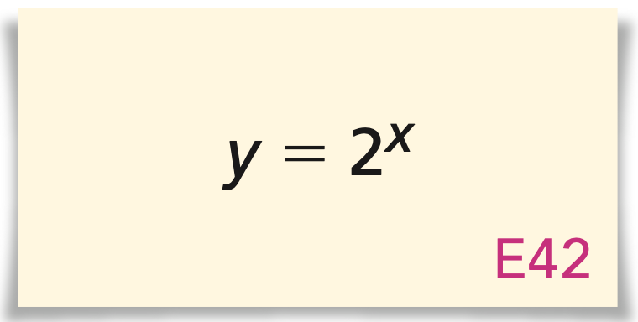
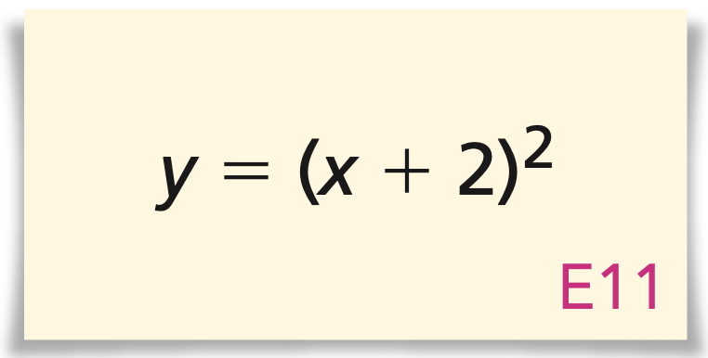
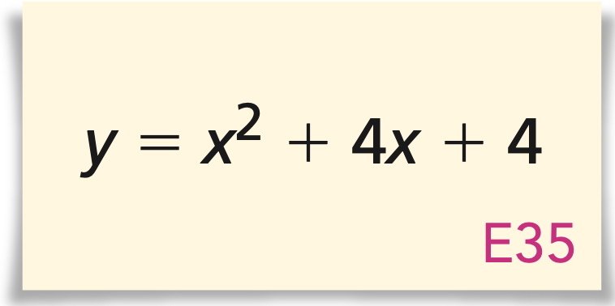
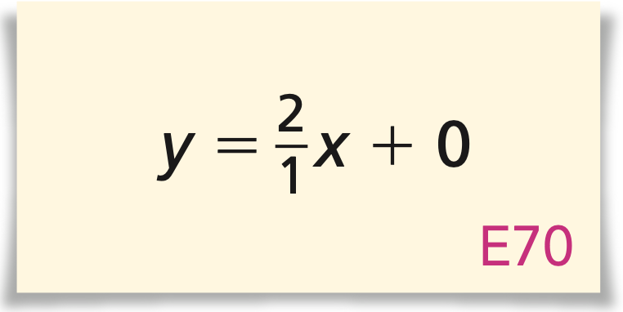

Slide 5
